Slide 1
Sign2Text
Belal Chaudhary
18/10/2017
Notes:
Sign language statistics:
5-10% of world population is deaf/hard-of-hearing
rely on sign language

Slide 2
Real-time translation of Sign Language into text
Objectives:
Translate ASL from images into text (‘Sign2Text’)
Focus on the ASL alphabet (A-Z)
Notes:
English dictionary: 171,476 words in use
ASL dictionary: ~10-30,000 words + lots of regional/country dialect
fingerspelling used for names, emphasis and ‘loan’ words from English

Slide 3
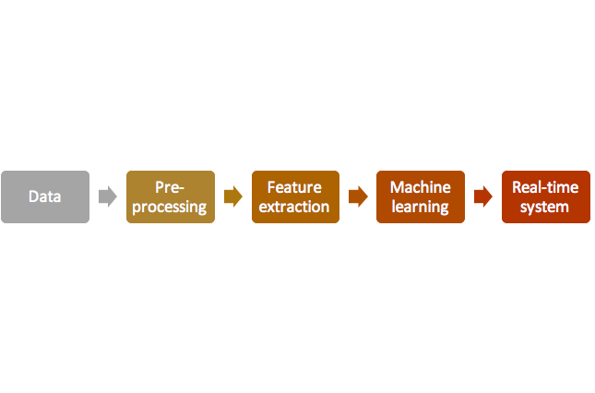
Pipeline
Pillow

Slide 4
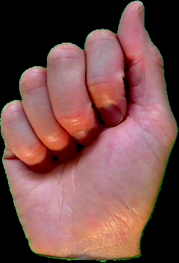
Iteration 1
ASL BU Corpus
~1500 images

Slide 5
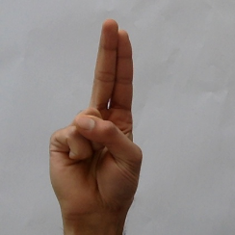

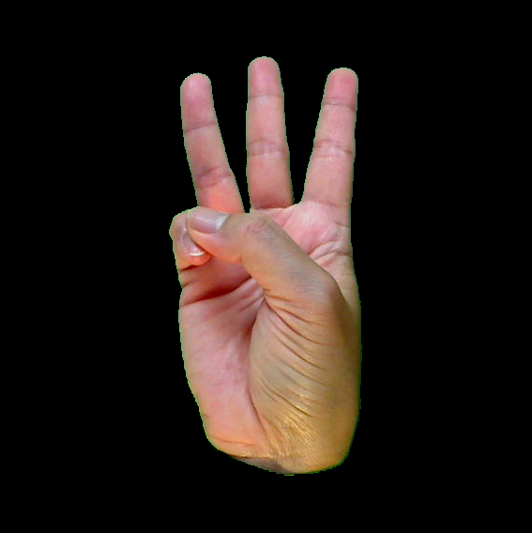
U
V
W

Slide 6
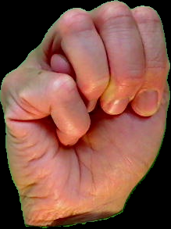
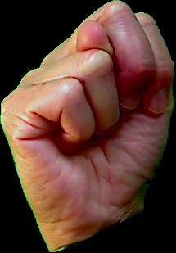
M
N
A

Slide 7
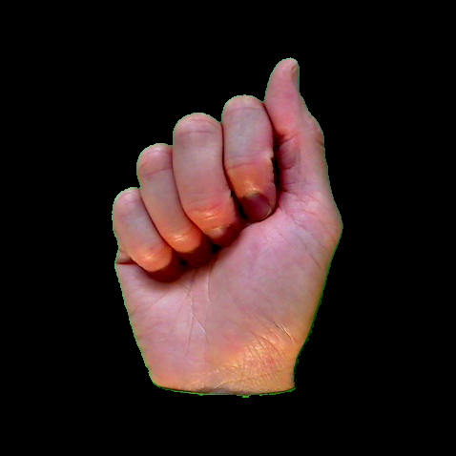
244 x 244
Raw image
Padding
Re-size for NN
~1500 images
~55 / class

Slide 9
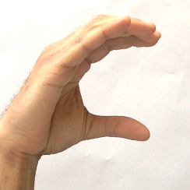
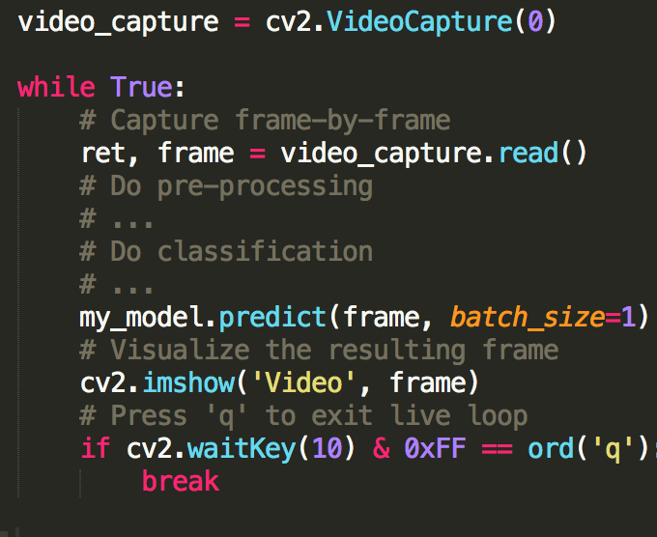
Notes:
Lighting
Hand tracking
Complex backgrounds

Slide 10
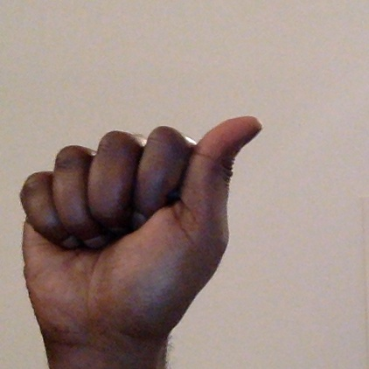
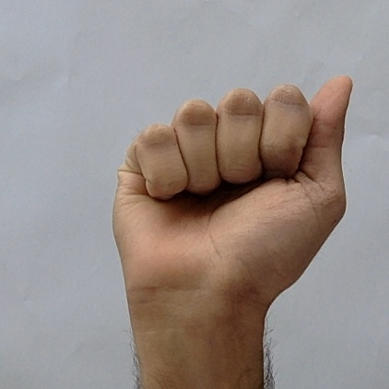
Iteration 2
ASL BU Corpus
~1500 images
+
Crowdsourced
~300 images

Slide 11
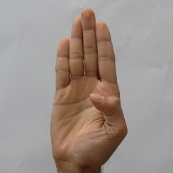
B
C
A

Slide 12
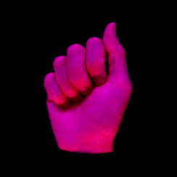
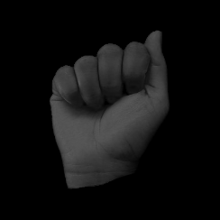
244 x 244
Padding
+
BGR editing
Raw image
Re-size for NN
~2000 images
~75 / class

Slide 13
Model | Size | Top-1 Accuracy | Top-5 Accuracy | Parameters | Depth
Xception | 88 MB | 0.790 | 0.945 | 22,910,480 | 126
VGG16 | 528 MB | 0.715 | 0.901 | 138,357,544 | 23
VGG19 | 549 MB | 0.727 | 0.910 | 143,667,240 | 26
ResNet50 | 99 MB | 0.759 | 0.929 | 25,636,712 | 168
InceptionV3 | 92 MB | 0.788 | 0.944 | 23,851,784 | 159
InceptionResNetV2 | 215 MB | 0.804 | 0.953 | 55,873,736 | 572
MobileNet | 17 MB | 0.665 | 0.871 | 4,253,864 | 88
The top-1 and top-5 accuracy refers to the model's performance on the ImageNet validation dataset
Notes:
number of correct predictions made divided by the total number of predictions made
ResNet - Residual net with 50 layers (Microsoft)
VGG16 - 16 layers (Uni of Oxford)
my CNN - 2 conv layers + 1 max pool

Slide 14
Transfer learning
VGG16 Architecture
1000 classes

Slide 15
Transfer learning
Classification block
VGG16 architecture
Flatten
FC (256)
Dropout
FC (26)
+ softmax activation
Probabilities / class

Slide 16
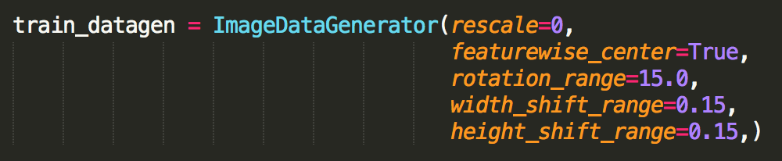
DATA AUGMENTATION
applied every epoch

Slide 17
Model | Average FPS | Classification Block | Random Forest
 |  | Accuracy | Accuracy
VGG16 | 1.69 | 0.997 | 0.853
ResNet50 | 2.87 | 0.999 | 0.799
InceptionV3 | - | - | 0.818
Xception | - | - | 0.767
MobileNet | 5.66 | 0.997 | 0.687
Testing done using:
MacBook Pro
16 GB 1600 MHz DDR3
2.2 GHz Intel Core i7
Notes:
number of correct predictions made divided by the total number of predictions made
ResNet - Residual net with 50 layers (Microsoft)
VGG16 - 16 layers (Uni of Oxford)
my CNN - 2 conv layers + 1 max pool

Slide 18
Public repo: https://github.com/BelalC/sign2text
Notes:
Links to ASL/local sign languages communities
Host on a web app for education
Open-source on GitHub -> ready to train on other examples
#Hand detection?
#Expand training examples/words?

Slide 19
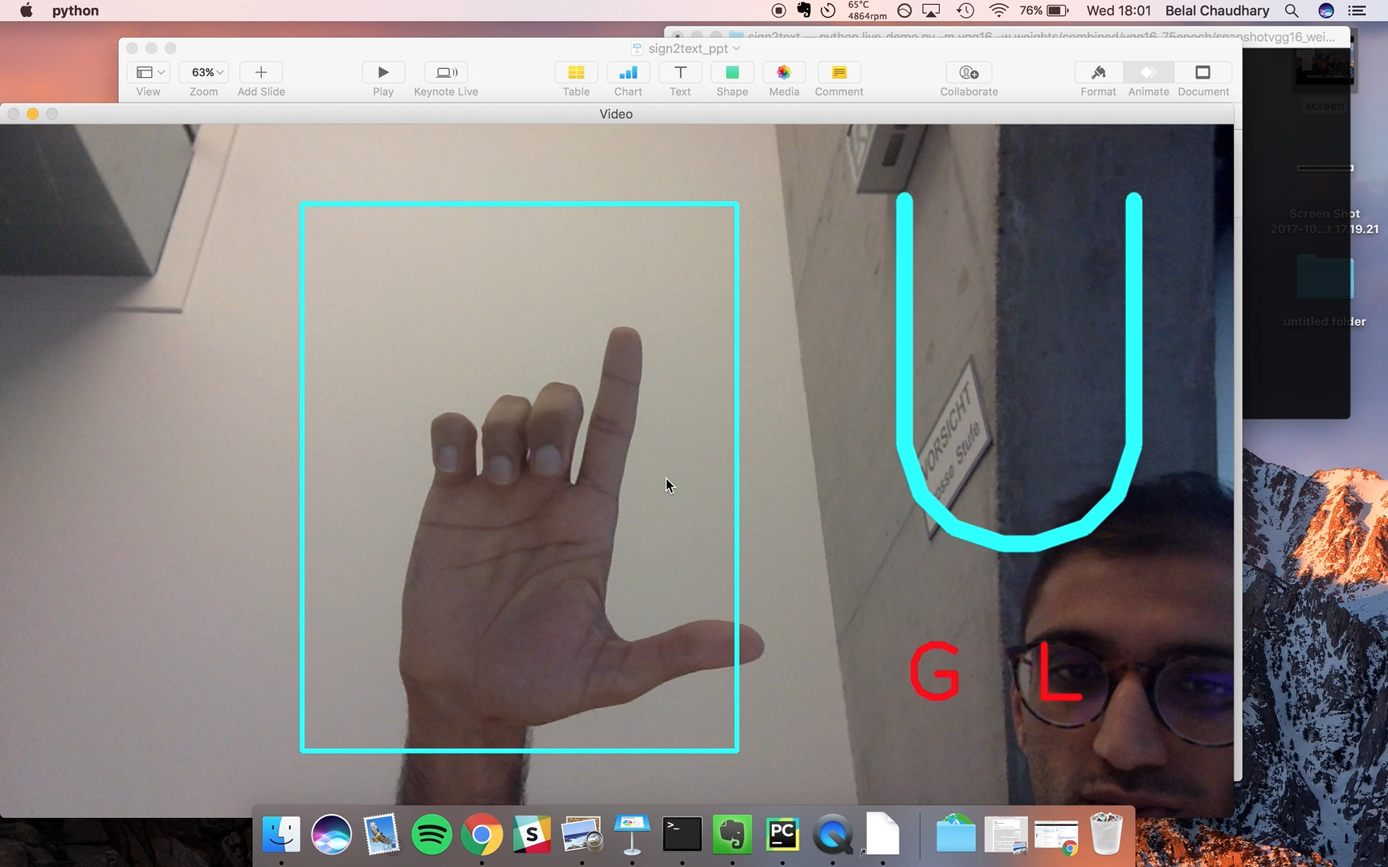
VGG16 Demo - ~2 frames/ second
Notes:
Links to ASL/local sign languages communities
Host on a web app for education

Slide 20
Future work
More data! (& augmentation)
Word & sentence-level translation
Other sign languages
Hand tracking
Port to mobile/embedded systems
Speech2Text

Slide 21
Thanks
Let’s talk…
Volunteer signers, interpreters, signing community
Boston University
Data science
Deep learning
Text, images, time-series
Biotechnology
/BelalC
/belalchaudhary

Slide 22
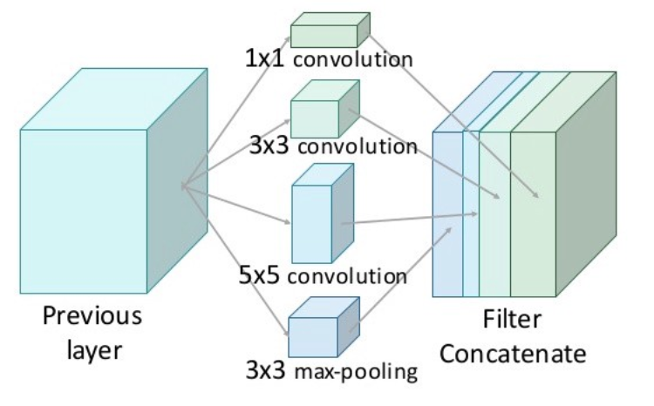
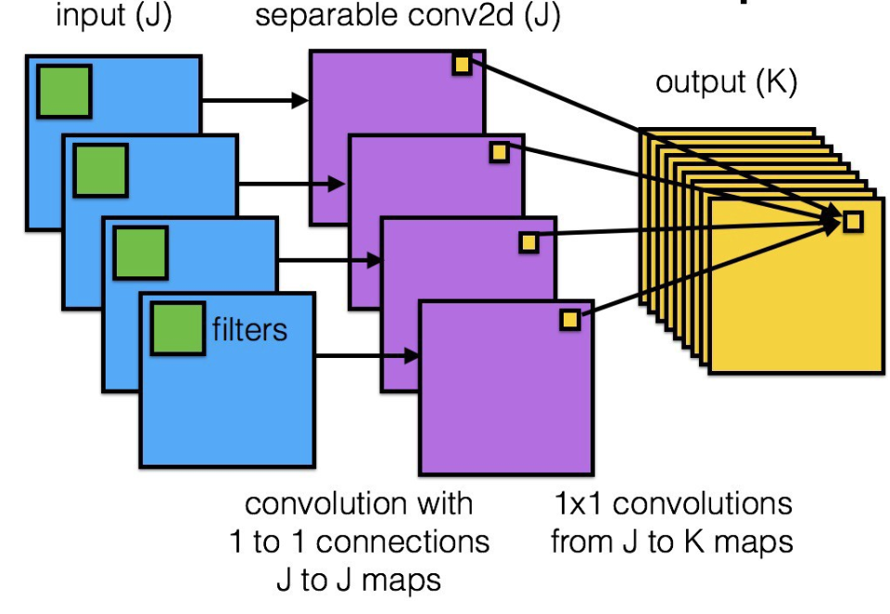
Appendix
Transfer learning with Keras:
https://blog.keras.io/building-powerful-image-classification-models-using-very-little-data.html
Deep learning architectures:
https://medium.com/towards-data-science/an-intuitive-guide-to-deep-network-architectures-65fdc477db41
‘Naive’ Inception Module
Xception network

Slide 23
Appendix
VGG16 Architecture

Slide 24
Appendix
Convolutional neural networks, transfer learning & more
http://setosa.io/ev/image-kernels/
http://cs231n.github.io/
http://cs231n.github.io/transfer-learning/

